Slide 1

Shapes in Python

Slide 2

Objectives
Shapes
Creating a line
Creating a square
Creating a circle
Creating advanced shapes

Slide 3
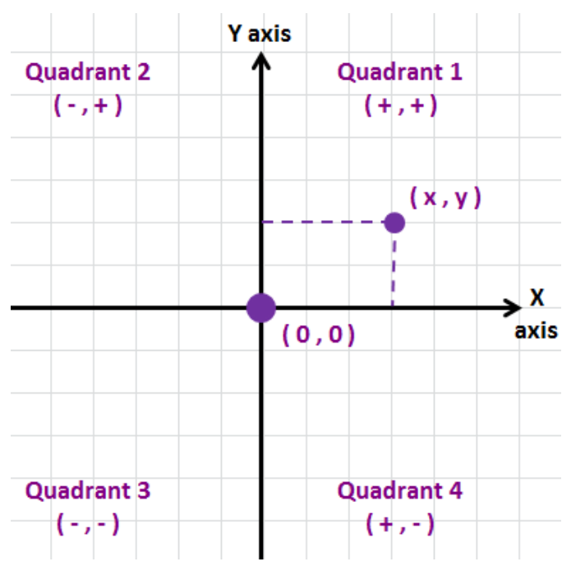
Shapes
What is Turtle?
Objects.
Directions.
Colors.

Slide 4
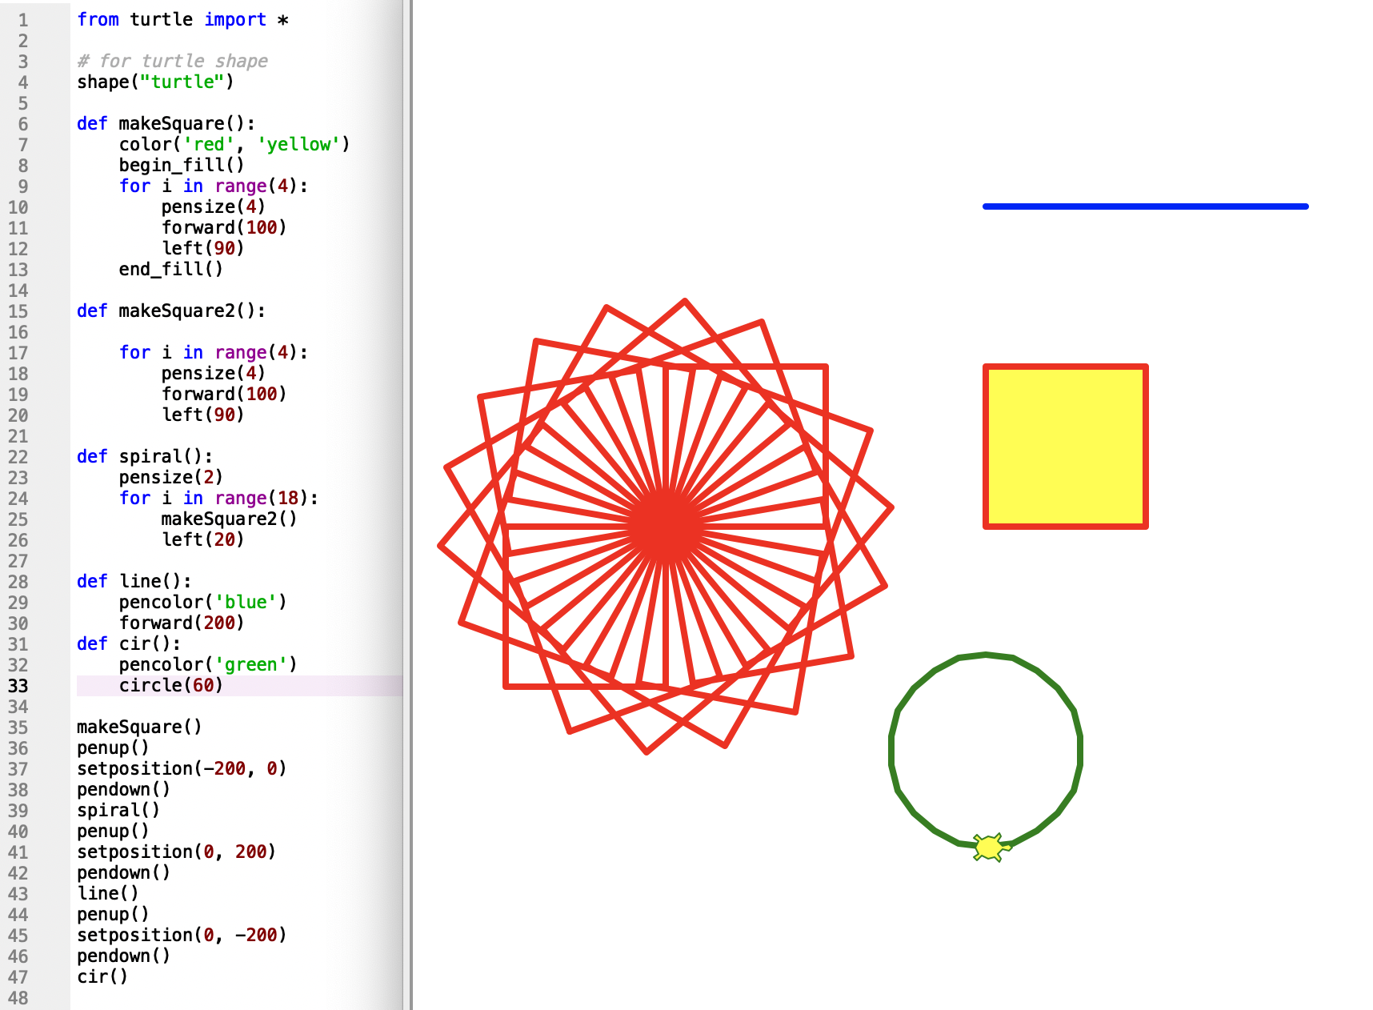
Shapes
Basic movements
forward()
back()
left()
right()

Slide 5
Demo

